Slide 1
Hack the Future:
A Gen AI Sprint Powered by Data

Slide 2



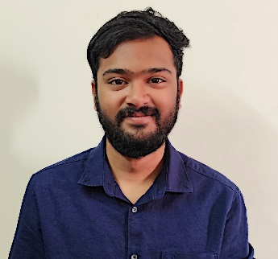
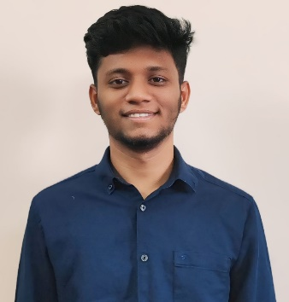
Hack the Future: A Gen AI Sprint Powered by Data
Data and AI Week
Team details
TEAM NAME: ByteCure
Vaddi Akhil(Team Leader)
Arangi Bharath Chandra
Photo

Slide 3
Entry Submission Summary
Idea Title (Provide a concise and impactful title for your idea.) | ElderEase: Tech with a Tender Touch
Team Name | ByteCure
Problem Statement | Elderly individuals living independently face challenges in monitoring their health, safety, and daily activities, which can lead to delayed assistance during emergencies and reduced quality of life.
Proposed Solution | Implement an intelligent, multi-agent system—ElderEase: Tech with a Tender Touch—that continuously monitors vital health parameters, detects safety hazards (e.g., falls), and sends friendly, personalized reminders and alerts to both the elderly and their caregivers, ensuring timely interventions and enhanced well-being.

Slide 4
Problem statement you are trying to address
Many seniors living independently find it challenging to keep up with regular health monitoring and often lack immediate support during emergencies. This gap in care can compromise their overall well-being, underscoring the need for a user-friendly system that offers constant monitoring and delivers timely alerts to both the elderly and their caregivers.

Slide 5
Proposed Solution Overview
Brief approach description or methodology used to tackle the problem
Continuous Monitoring: Use wearable sensors and data feeds to track vital signs in real time.
Instant Alerts: Automatically detect falls and unusual inactivity to quickly notify caregivers.
Personalized Reminders: Deliver gentle notifications for medications and daily activities.
User-Friendly Dashboard: Provide an intuitive interface with clear visuals and supportive messaging.
Integrated Care: Seamlessly combine health, safety, and reminder modules for proactive support.

Slide 6
Technologies Used
List the key technologies, frameworks, and tools you utilized in your solution
Backend: Python with Flask for web application development
Database: PostgreSQL with psycopg2 for data management
Data Processing: Pandas for CSV data manipulation
Frontend: HTML, CSS, and JavaScript for user interfaces
Natural Language Generation: Ollama (using models like mistral) for generating friendly, elder-appropriate messages
IoT Integration (Conceptual): Wearable sensors for real-time health monitoring

Slide 7
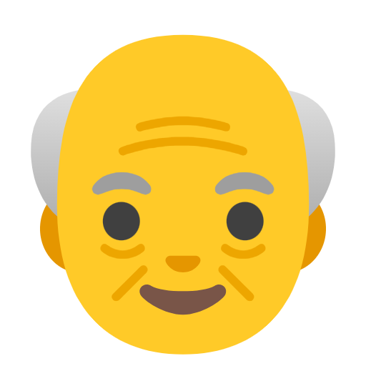
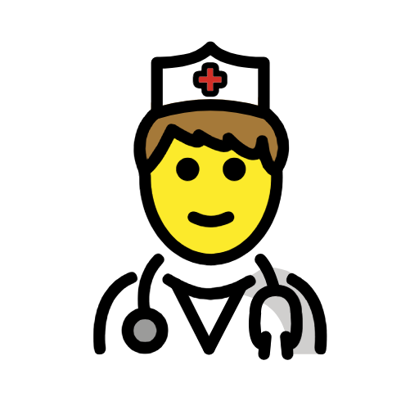


Agents' interaction design
Elder User (Device Agent)
Caretaker
Agent
Interacts via a simple interface Receives friendly alerts and reminders
Accesses monitoring dashboard Sets schedules, receives alerts
Monitoring Agent
Notification Agent
Tracks vital signs
Triggers alerts and reminders Uses natural language gener

Slide 8
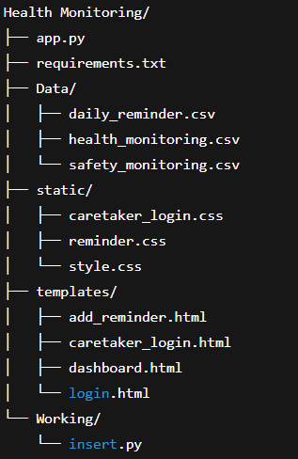
Code structure

Slide 9
Demo video
https://drive.google.com/file/d/1N5YK7TnQtogcvppLN48zK_yZ89GwquDJ/view?usp=sharing

Slide 10
Conclusion
Summarize the impact and effectiveness of your solution. Reiterate how it solves the problem statement.
Our system is designed with care, keeping the needs of elderly individuals in mind—especially those who live alone. It brings together real-time health and safety tracking with friendly, easy-to-understand reminders. This means quicker help in emergencies and fewer missed routines. Overall, it supports safer, more independent living while giving peace of mind to both seniors and their loved ones.

Slide 11
References/Other details
https://youtu.be/Lb5D892-2HY?si=oV9siVY9-MJ45sPb
https://ollama.ai
OpenAI for Some Concepts
Future Scope: Integration with wearable devices, mobile alerts, and multilingual support
LLM Integration: Personalized and simplified messages using models like Mistral via Ollama

Slide 12
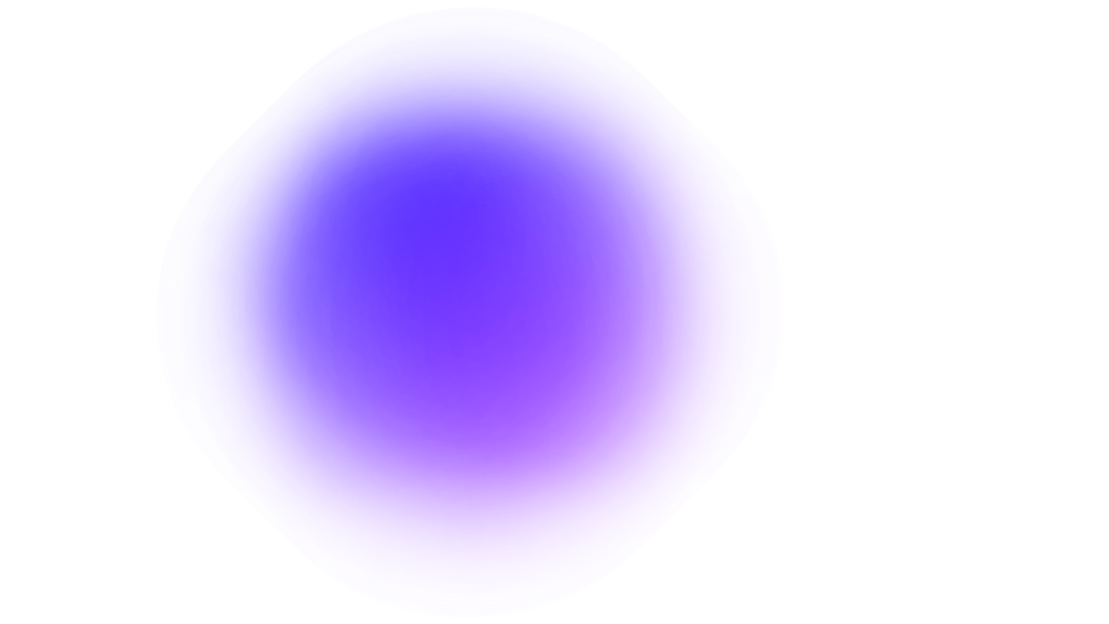
Thank You

